Slide 1

Data Privacy
Computer System Principles, Fall 2020 (IPADS, SJTU)
Protecting Your Data from Anyone
Yubin Xia

Slide 2
Data Privacy
Data can be used everywhere
  Risk management
  Medicine
  Recommended system
  …
Data can be stolen easily
  Everyone who uses your data can steal it

Slide 3
Data Privacy
What's the target of data privacy system?
  Allow data to be used, and
  Protect data from being stolen
What will be introduced?
  Basic data privacy method
    ZKP, OT, HE, sMPC, TEE, DP
  Systems which try to enforce data privacy

Slide 4
TEE
Trusted Execution Environment

Slide 5

Problem
I have computing resource!
I have Data!
Data
Bob (cloud)
Alice wants to ask Bob (e.g., a cloud) to perform calculation on her data
Naïve method: Sending Data to Bob

Slide 6
Problem
I have computing resource!
I have Data!
Data
Bob (cloud)
Alice wants to ask Bob (e.g., a cloud) to perform calculation on her data
Naïve method: Sending Data to Bob

Slide 7
Trusted Execution Environment
I have computing resource and TEE!
I have Data!
Data
Bob (cloud)
Alice wants to ask Bob (e.g., a cloud) to perform calculation on her data
Naïve method: Sending Data to Bob
Bob cloud construct a TEE

Slide 8
What is TEE
TEE
Trusted
Host App
Enclave App
Non-sensitive code/data
Sensitive code/data
User
OS
Supervisor
Hypervisor
Hypervisor
TEE/Enclave extension
Hardware

Slide 9
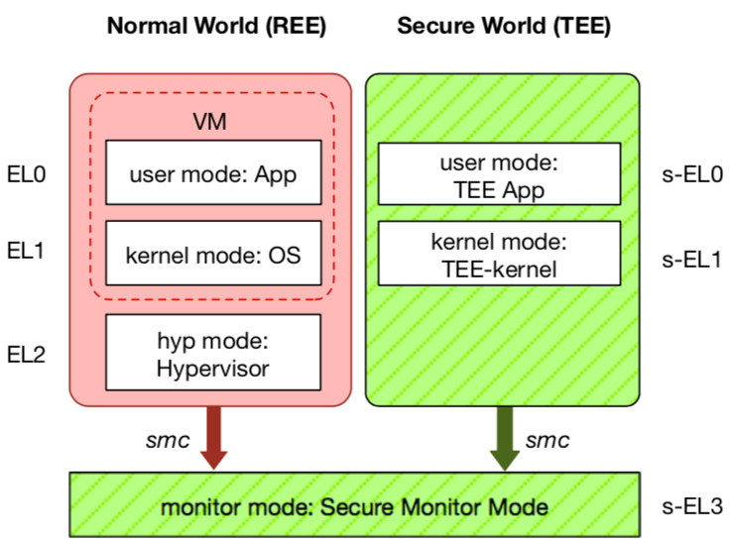
TEE: Trusted Execution Environment
Widely deployed on mobile devices
  Every Android device must deploy TEE
  Mostly based on ARM TrustZone
An isolated & privileged environment
  TEE can access all DRAM & peripherals
  REE cannot access TEE's resources
Designed to be secured and small
  For security-critical tasks (e.g., fingerprint
  checker, mobile payment, etc.)
Notes:
Before presenting virtualization of TEE, let me introduce TEE a little bit.
TEE is short for xxx. It has been widely deployed on mobile devices. Thanks to Google, now every Android phone needs to have TEE to pass Google's test.
On mobile phone, most TEE are based on ARM TrustZone.
TrustZone divides one system to two worlds: xxx and xxx.
The normal world, aka REE, runs rich OS like Android or iOS. It has three layers: one for hypervisor, one for kernel and one for application.
The secure world, aka TEE, has three layers: one for TEE OS and one for TEE applications.
There is a special layer, called monitor mode or s-EL3, is used for switching between the two worlds. It is also part of the secure world but share the same privilege with s-EL1.
The switching is done through smc instruction.
The green part is TEE, which is an isolated environment with higher privileged than the REE.
It means that xxx
The TEE is designed to xxx, its typical usage is xxx.

Slide 10
Different TEEs
Software TEE
  VM-based TEE
  Same privilege protection
ARM TrustZone
Intel SGX
AMD SME/SEV
SANCTUM
Notes:
However, the openness also leads to fragmentation.
Nowadays, there are many different kinds of TEE OS, from different venders.
Also, many other implementations based on OP-TEE.
This is not a good news for trusted app developers, since they need to port and trust.

Slide 11
ZKP
Zero-Knowledge Proof

Slide 12

Problem
It's impossible!
Prove it!
I have the answer A of the problem P!
A
Alice tries to prove to Bob that she has the answer of a difficult problem (e.g., a NP problem)
Naïve method: Sending A to Bob

Slide 13
Problem
Thanks!
Now, I have the answer A.
I have the answer A of the problem P!
A
Alice tries to prove to Bob that she has the answer of a difficult problem (e.g., a NP problem)
Naïve method: Sending A to Bob
  Problem: Bob will get the answer A

Slide 14

Zero-Knowledge Proof
OK, I can verify the proof.
I have the answer A of the problem P!
proof
Alice tries to prove to Bob that she has the answer of a difficult problem (e.g., a NP problem).
Zero-Knowledge Proof
  Completeness: Alice can construct the proof if she has A
  Soundness: Alice cannot construct the proof if she doesn't have A
  Zero-knowledge: Bob knows nothing about A

Slide 15
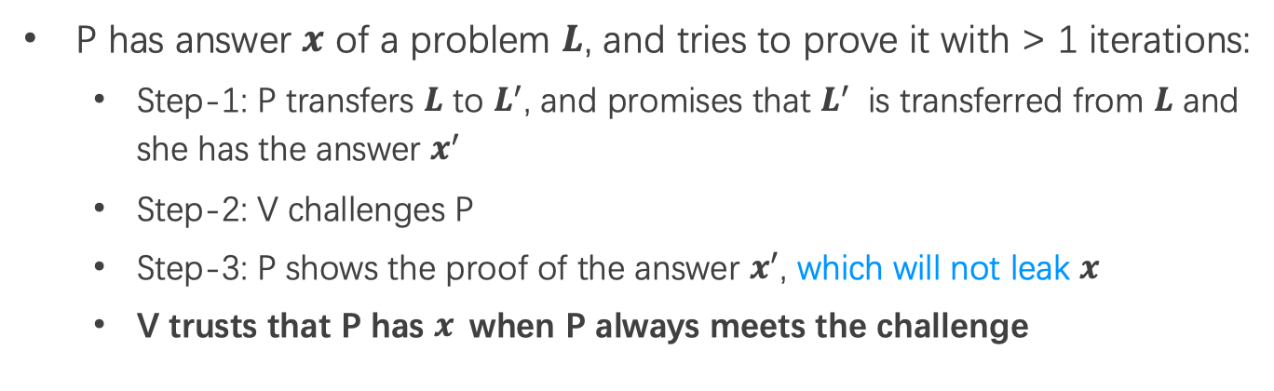
Interactive Zero-Knowledge Proof
I am verifier: V
I am prover: P
promise
1
challenge
response
2
P has answer $x$ of a problem $L$, and tries to prove it with > 1 iterations:
  Step-1: P transfers $L$ to $L^{′}$, and promises that $L^{′}$ is transferred from $L$ and she has the answer $x^{′}$
  Step-2: V challenges P
  Step-3: P shows the proof of the answer $x^{′}$, which will not leak $x$
  V trusts that P has $x$when P always meets the challenge

Slide 16
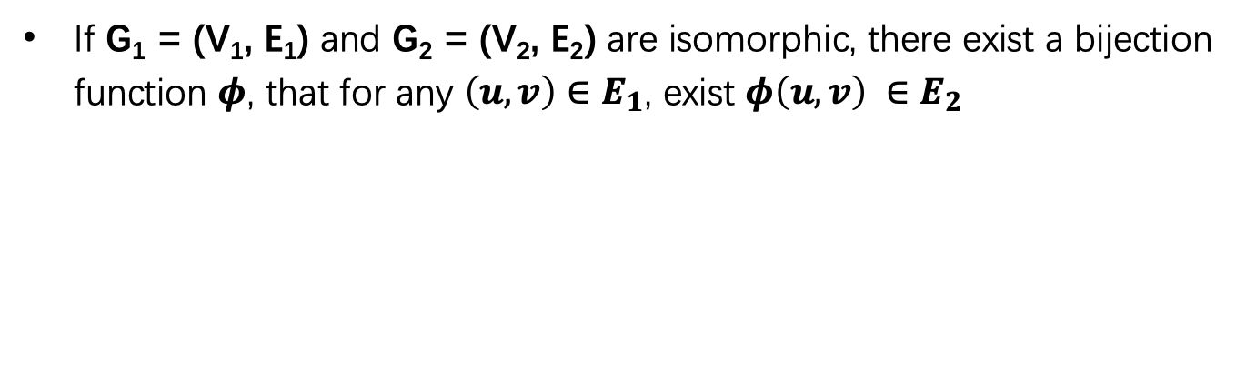
Graph Isomorphism
2
1
1
4
2
4
3
3
6
5
5
6
G_{e}
G_{f}
If G₁ = (V₁, E₁) and G₂ = (V₂, E₂) are isomorphic, there exist a bijection function $φ$, that for any $\left(u, v\right)∈E_{1}$, exist $φ\left(u, v\right) ∈E_{2}$

Slide 17
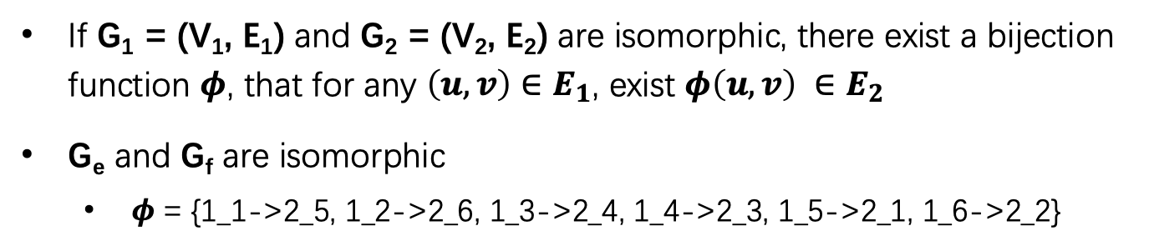

Graph Isomorphism
2
1
1
$$G_{e}≃G_{f}$$
4
2
4
3
3
6
5
5
6
G_{e}
G_{f}
If G₁ = (V₁, E₁) and G₂ = (V₂, E₂) are isomorphic, there exist a bijection function $φ$, that for any $\left(u, v\right)∈E_{1}$, exist $φ\left(u, v\right) ∈E_{2}$
G_{e} and G_{f} are isomorphic
  $φ$ = {1_1->2_5, 1_2->2_6, 1_3->2_4, 1_4->2_3, 1_5->2_1, 1_6->2_2}

Slide 18


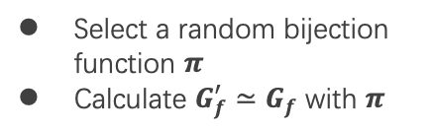

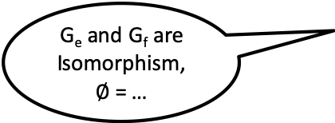


Graph Isomorphism w/ Interactive ZKP
G_{e} and G_{f} are Isomorphism, $∅$ = …
Select a random bijection function $π$
Calculate $G_{f}^{′}≃G_{f}$ with $π$
$G_{f}^{′}$ $≃G_{f}$ $≃G_{e}$
Ask Alice to prove ${G_{σ}≃G}_{f}^{′}$
Select a random $σ∈\left\{e, f\right\}$
If $σ$=f, send $π$
If $σ$ = e, send $π∙∅$
Verify that ${G_{σ}≃G}_{f}^{′}$
Notes:
sigma

Slide 19

Graph Isomorphism w/ Interactive ZKP
G_{e} and G_{f} are Isomorphism, $∅$ = …
Select a random bijection function $π$
Calculate $G_{f}^{′}≃G_{f}$ with $π$
$G_{f}^{′}$ $≃G_{f}$ $≃G_{e}$
Ask Alice to prove ${G_{σ}≃G}_{f}^{′}$
Select a random $σ∈\left\{e, f\right\}$
Require too much
interactions!
If $σ$=f, send $π$
If $σ$ = e, send $π∙∅$
Verify that ${G_{σ}≃G}_{f}^{′}$

Slide 20

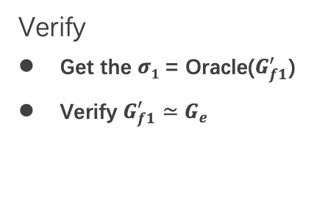
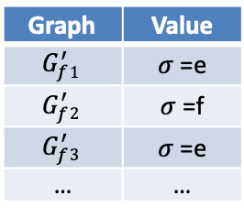

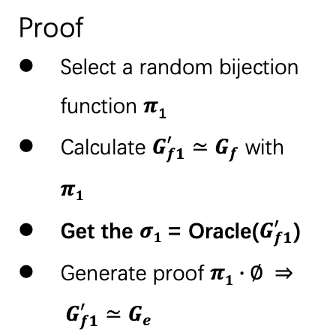



Non-Interactive ZKP
$${1. G}_{f1}^{′}≃G_{f}≃G_{e}$$
2. $π1∙∅ ⇒ G_{f1}^{′}≃G_{e}$
Proof
Select a random bijection function $π$₁
Calculate $G_{f1}^{′}≃G_{f}$ with $π1$
Get the $σ1$= Oracle($G_{f1}^{′}$)
Generate proof $π1∙∅ ⇒ G_{f1}^{′}≃G_{e}$
Verify
Get the $σ1$= Oracle($G_{f1}^{′}$)
Verify $G_{f1}^{′}≃G_{e}$
$$G_{f1}^{′}$$
$$G_{f1}^{′}$$
$σ$=e
$σ$=e
Graph | Value
$$G_{f}^{′}1$$ | $σ$=e
$$G_{f}^{′}2$$ | $σ$=f
$$G_{f}^{′}3$$ | $σ$=e
… | …
I am a trusted Random Oracle!
I can provide a random sequence.

Slide 21
OT
Oblivious Transfer

Slide 22
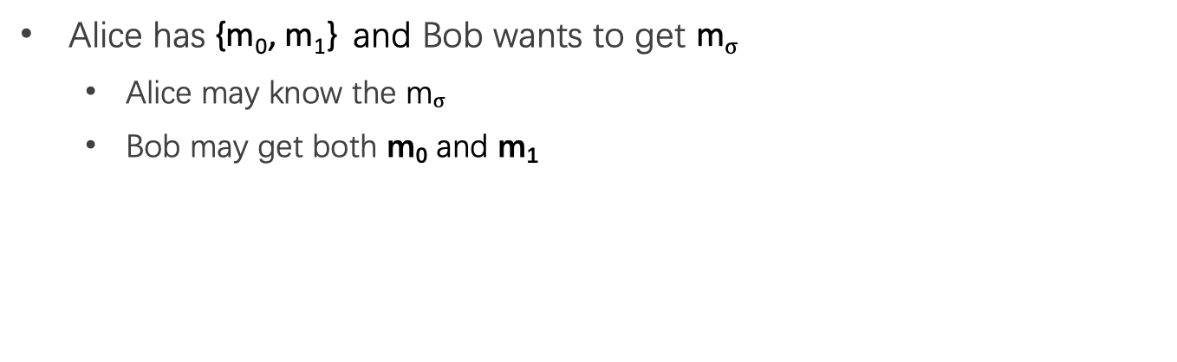
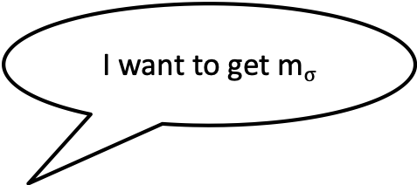
Problem
I want to get m$σ$
I have {m₀, m₁}
Alice has {m₀, m₁} and Bob wants to get m$σ$
  Alice may know the m$σ$
  Bob may get both m₀ and m₁

Slide 23
Oblivious Transfer
Scenario: message transfer
  A sender has a message list {m₀, m₁, … , m_{n}}
  A receiver wants to get k target messages from sender
Properties: oblivious and secure
  Oblivious: sender cannot know which messages are received
  Secure: receiver can only get the target messages

Slide 24
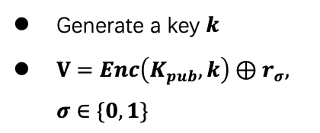


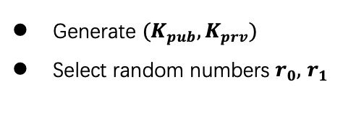

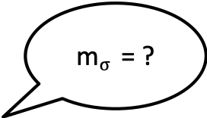
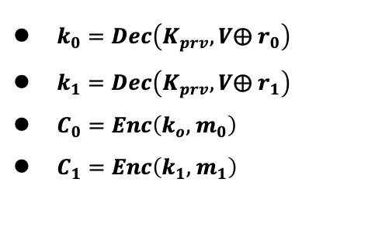

1-out-of-2 OT
m$σ$ = ?
{m₀, m₁}
Generate ${(K}_{pub}, K_{prv})$
Select random numbers $r_{0},$ $r_{1}$
$$K_{pub}, r_{0},r_{1}$$
Generate a key $k$
$V=Enc\left(K_{pub}, k\right)⊕r_{σ}, σ∈\{0,1\}$
$$V$$
$k_{0}=Dec\left(K_{prv},V⨁{ r}_{0}\right)$
$k_{1}=Dec\left(K_{prv},V⨁{ r}_{1}\right)$
$C_{0}=Enc\left(k_{o}, { m}_{0}\right)$
$C_{1}=Enc\left(k_{1}, { m}_{1}\right)$
$$C_{o},C_{1}$$
$m_{σ} =Dec\left(k, C_{σ}\right)$
Notes:
Alice分别用两个解密结果加密她的两份消息，将加密结果送给Bob （Ci=E(ki, mi) i=0,1）
Bob用k解密两份密文，得到需要的秘密 s

Slide 25
More OT Protocols
Different numbers of selected messages
  1-out-of-2 OT:
  1-out-of-n OT
  k-out-of-n OT
Implementation method
  Non-adaptive OT
  Adaptive OT
  Publicly Verifiable OT
  …

Slide 26
HE
Homomorphic Encryption

Slide 27
Problem
I have computing resource!
I have Data!
Data
Bob (cloud)
Alice wants to ask Bob (e.g., a cloud) to perform calculation on her data
Naïve method: Sending data to Bob

Slide 28
Problem
I have computing resource!
I have Data!
Data
Bob (cloud)
Alice wants to ask Bob (e.g., a cloud) to perform calculation on her data
Naïve method: Sending Data to Bob
  Bob will get the data

Slide 29
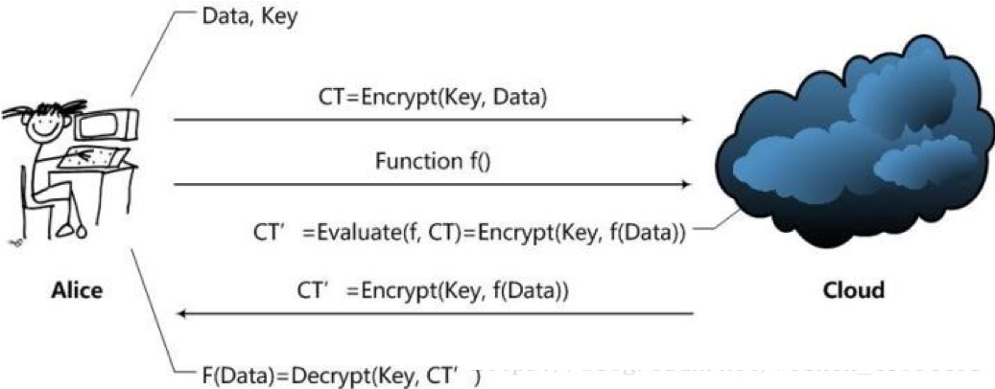
Homomorphic Encryption
Alice sends CT=encrypt(Key, Data) and function f to the Cloud
Cloud calculates CT'= Evaluate(f, CT) = Encrypt(Key, f(Data))
Alice gets f(Data) = Decrypt(Key, CT')

Slide 30
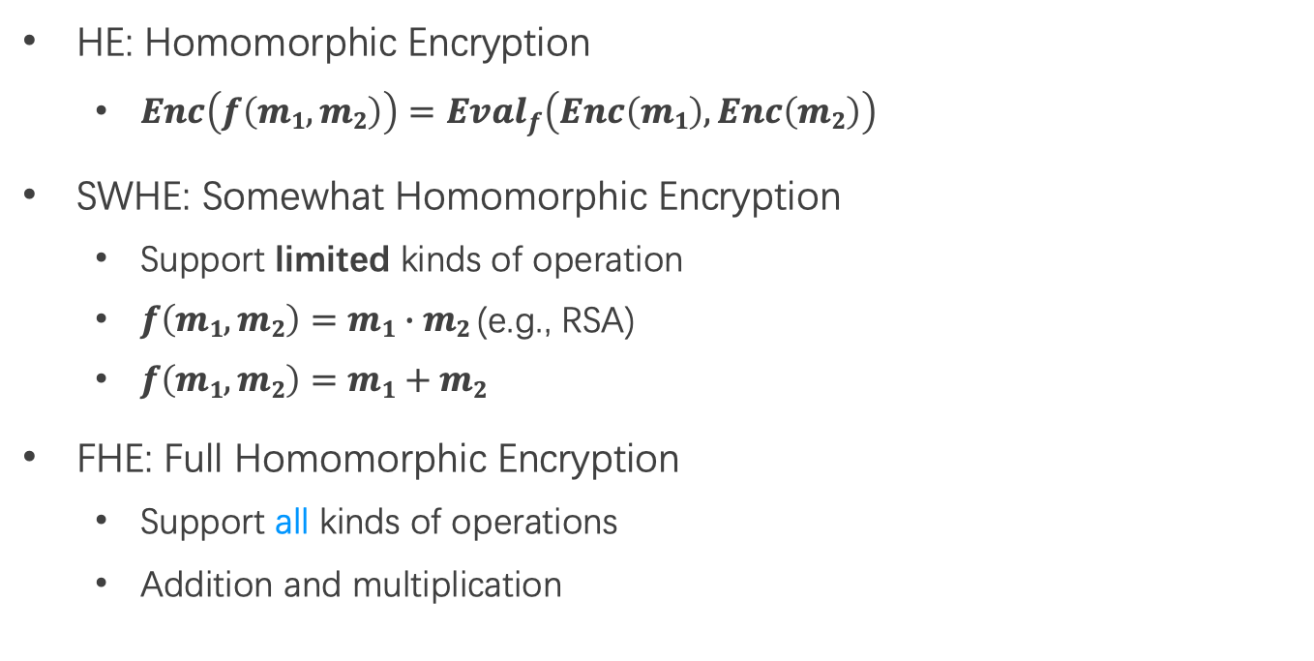
SWHE and FHE
HE: Homomorphic Encryption
  $Enc\left(f\left(m1,m2\right)\right)={Eval}_{f}\left(Enc\left(m1\right), Enc\left(m2\right)\right)$
SWHE: Somewhat Homomorphic Encryption
  Support limited kinds of operation
  $f\left(m1,m2\right)=m1∙m2$ (e.g., RSA)
  $f\left(m1,m2\right)=m1+m2$
FHE: Full Homomorphic Encryption
  Support all kinds of operations
  Addition and multiplication

Slide 31
SMPC
Secure Multi-Party Computing

Slide 32
Problem
We want to calculate
f(data₁, data₂)
I have data₂
I have data₁
Multiple parties (at least 2) work together to calculate a function
  Enforce the data privacy for each party
Notes:
Alice分别用两个解密结果加密她的两份消息，将加密结果送给Bob （Ci=E(ki, mi) i=0,1）
Bob用k解密两份密文，得到需要的秘密 s

Slide 33
Yao's Protocol
Two-party computing
Semi-honest adversary
  Each party must follow the protocol
Generic protocol
  Can securely compute any functionality
GC(Garbled Circuits)+OT(Oblivious Transfer)

Slide 34
Millionaire Problem
Money: Wang has i, Lee has j, i and j are between 1 to 10
Lee (money: j)
  Chose a random big integer x
  K = enc{Key_{pub} of Wang, x}
  Send c=K-j to Wang
Wang (money: i)
  Decrypt with Key_{pri} of Wang ten number: c+1, c+2...c+10, get y1, y2... y10
  Chose a prime number p
  Calculate d1 = y1 mod p
  For n=i to 10, d_{n}++, other no change
  Send d1 to d10 to Lee
Lee
  Check dj, if dj == x mod p, then i >= j; else i < j
Notes:
如果等于 x mod p 的话，说明这个数字没有被加一，所以 i >= j. 反之，则 i < j。

Slide 35
Garbled Circuits
Represent functions as Boolean circuits
  Basic gates: AND, OR, NOT
  Adding numbers
  Comparing numbers
  Multiplying numbers
  Computing AES
Represent input and output as wires

Slide 36
Garbled Circuits
An encrypted circuits together with a pair of keys (k₀,k₁) for every wire so that for any gate, given one key for every input wire:
  It is possible to compute the key of the corresponding gate output
  It is impossible to learn anything else

Slide 37
An AND Gate
u | v | w
0 | 0 | 0
0 | 1 | 0
1 | 0 | 0
1 | 1 | 1
w
0
1
0
1
0
1
u
v

Slide 38
An AND Gate with Garbled Value
u | v | w
k_{u}⁰ | K_{v}⁰ | K_{w}⁰
k_{u}⁰ | k_{v}¹ | K_{w}⁰
k_{u}¹ | k_{v}⁰ | K_{w}⁰
k_{u}¹ | k_{v}¹ | K_{w}¹
w
k_{w}⁰
k_{w}¹
k_{u}⁰
k_{u}¹
k_{v}⁰
k_{v}¹
u
v

Slide 39
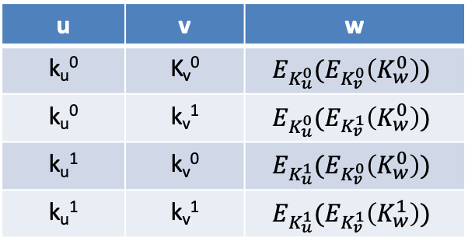
A Garbled AND Gate
u | v | w
k_{u}⁰ | K_{v}⁰ | $$E_{K_{u}^{0}}(E_{K_{v}^{0}}\left(K_{w}^{0}\right))$$
k_{u}⁰ | k_{v}¹ | $$E_{K_{u}^{0}}(E_{K_{v}^{1}}\left(K_{w}^{0}\right))$$
k_{u}¹ | k_{v}⁰ | $$E_{K_{u}^{1}}(E_{K_{v}^{0}}\left(K_{w}^{0}\right))$$
k_{u}¹ | k_{v}¹ | $$E_{K_{u}^{1}}(E_{K_{v}^{1}}\left(K_{w}^{1}\right))$$
w
k_{w}⁰
k_{w}¹
k_{u}⁰
k_{u}¹
k_{v}⁰
k_{v}¹
u
v

Slide 40
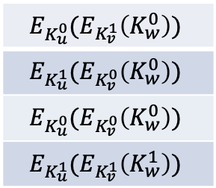
A Garbled AND Gate
The actual garbled gate
Given K_{u}⁰ and K_{v}¹ and only obtain K_{w}⁰
Since the order of the rows is permuted, the party has no idea if it obtained the 0 or 1 key
w
$$E_{K_{u}^{0}}(E_{K_{v}^{1}}\left(K_{w}^{0}\right))$$
$$E_{K_{u}^{1}}(E_{K_{v}^{0}}\left(K_{w}^{0}\right))$$
$$E_{K_{u}^{0}}(E_{K_{v}^{0}}\left(K_{w}^{0}\right))$$
$$E_{K_{u}^{1}}(E_{K_{v}^{1}}\left(K_{w}^{1}\right))$$
k_{w}⁰
k_{w}¹
k_{u}⁰
k_{u}¹
k_{v}⁰
k_{v}¹
u
v

Slide 41
Output Translation
If the gate is an output gate, also need to provide the "decryption" of the output wire
Output translation table:
  Naïve table: [(0, K_{w}⁰), (1, K_{w}¹) ]
  Secure table: [(0, Hash(K_{w}⁰)), (1, Hash(K_{w}¹)) ]
w
k_{w}⁰
k_{w}¹
k_{u}⁰
k_{u}¹
k_{v}⁰
k_{v}¹
u
v

Slide 42
Construct a Garbled Circuit
Given a boolean circuit
  Assign garbled value to all wires
  Construct garbled gates using the garbled values
Main property:
  A garbled value for each wire -> garbled values for output wire
  A translation table for output wires -> output value
  Nothing but the output value is learned

Slide 43
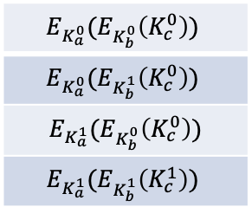
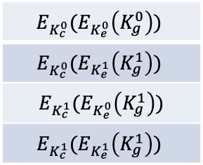
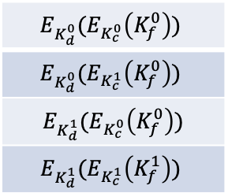
An Example Circuit
[(0, K_{f}⁰), (1, K_{f}¹) ]
[(0, K_{g}⁰), (1,K_{g}¹) ]
$$E_{K_{d}^{0}}(E_{K_{c}^{0}}\left(K_{f}^{0}\right))$$
$$E_{K_{d}^{0}}(E_{K_{c}^{1}}\left(K_{f}^{0}\right))$$
$E_{K_{d}^{1}}(E_{K_{c}^{0}}\left(K_{f}^{0}\right))$
$$E_{K_{d}^{1}}(E_{K_{c}^{1}}\left(K_{f}^{1}\right))$$
k_{f}⁰
k_{f}¹
k_{g}⁰
k_{g}¹
$$E_{K_{c}^{0}}(E_{K_{e}^{0}}\left(K_{g}^{0}\right))$$
$$E_{K_{c}^{0}}(E_{K_{e}^{1}}\left(K_{g}^{1}\right))$$
$E_{K_{c}^{1}}(E_{K_{e}^{0}}\left(K_{g}^{1}\right))$
$$E_{K_{c}^{1}}(E_{K_{e}^{1}}\left(K_{g}^{1}\right))$$
AND
OR
k_{d}⁰
k_{d}¹
k_{c}⁰
k_{c}¹
k_{e}⁰
k_{e}¹
$$E_{K_{a}^{0}}(E_{K_{b}^{0}}\left(K_{c}^{0}\right))$$
$$E_{K_{a}^{0}}(E_{K_{b}^{1}}\left(K_{c}^{0}\right))$$
$E_{K_{a}^{1}}(E_{K_{b}^{0}}\left(K_{c}^{0}\right))$
$$E_{K_{a}^{1}}(E_{K_{b}^{1}}\left(K_{c}^{1}\right))$$
AND
k_{a}⁰
k_{a}¹
k_{b}⁰
k_{b}¹
x2
x1
y1
y2

Slide 44
Computing a Garbled Circuit
How does the party know that it decrypted the "correct" entry?
  A gate has four entries
  The party only has keys for a single entry, but may decrypt "correct" even with incorrect key
Two methods (actually more…)
  Add redundant zeros to the plaintext
    Only correct keys get redundant block
    Transfer redundant block
    Decrypt all four entries
  Add a signal bit
    Signal which entry to decrypt

Slide 45
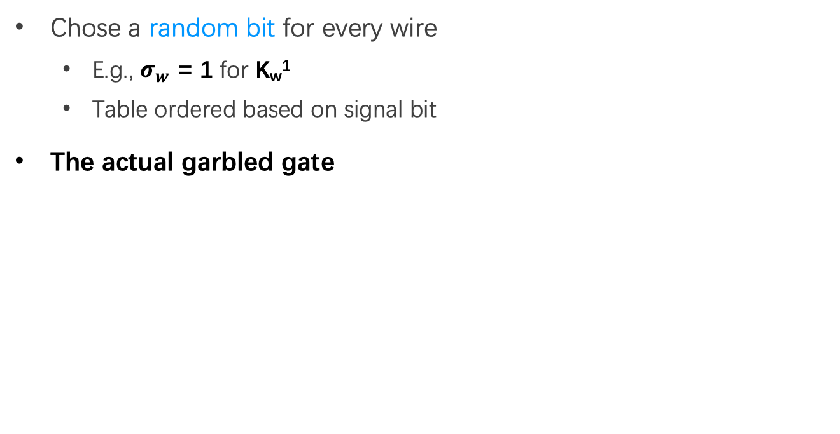
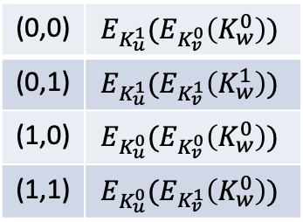



Signal Bit
Chose a random bit for every wire
  E.g., $σ_{w}$ = 1 for K_{w}¹
  Table ordered based on signal bit
The actual garbled gate
w
$$σ_{w}$$
k_{w}⁰
k_{w}¹
(0,0) | $$E_{K_{u}^{1}}(E_{K_{v}^{0}}\left(K_{w}^{0}\right))$$
(0,1) | $$E_{K_{u}^{1}}(E_{K_{v}^{1}}\left(K_{w}^{1}\right))$$
(1,0) | $$E_{K_{u}^{0}}(E_{K_{v}^{0}}\left(K_{w}^{0}\right))$$
(1,1) | $$E_{K_{u}^{0}}(E_{K_{v}^{1}}\left(K_{w}^{0}\right))$$
k_{u}⁰
k_{u}¹
k_{v}⁰
k_{v}¹
$$σ_{u}$$
$$σ_{v}$$
u
v

Slide 46
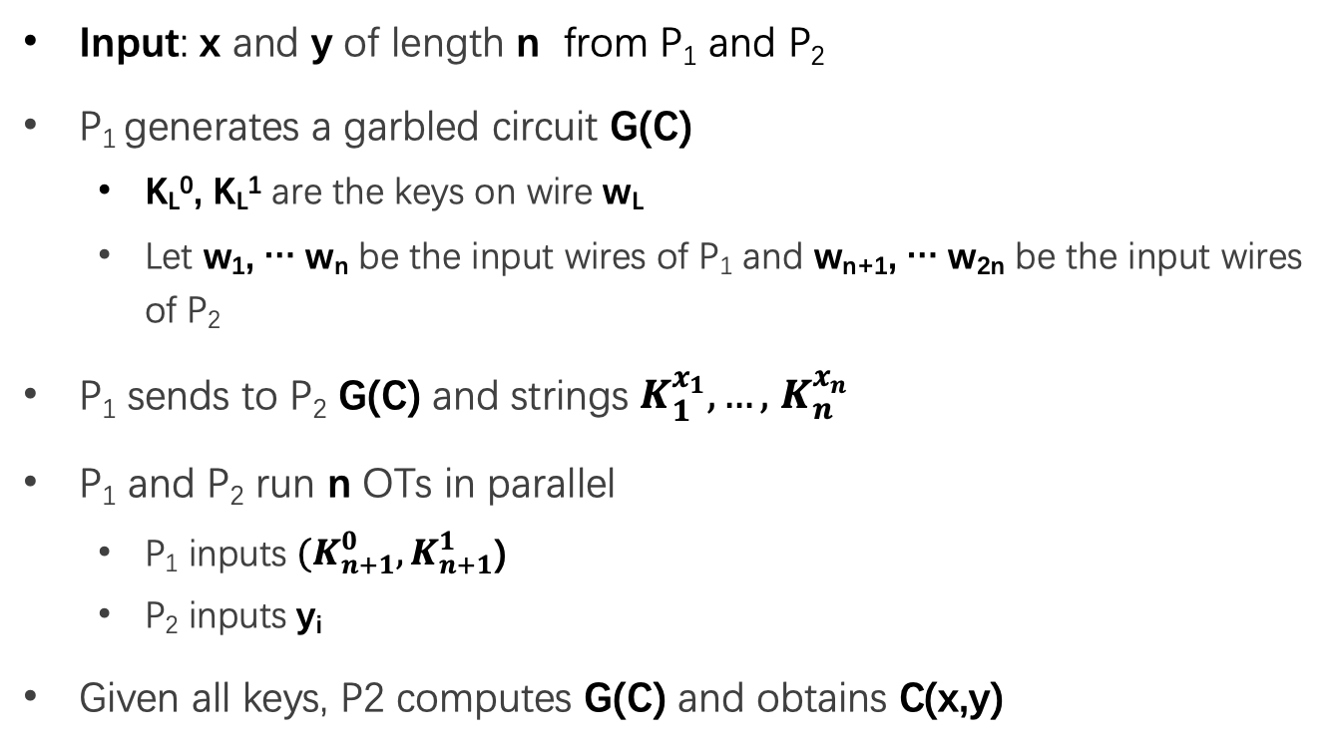
Yao's Protocol on GC
Input: x and y of length n from P₁ and P₂
P₁ generates a garbled circuit G(C)
  K_{L}⁰, K_{L}¹ are the keys on wire w_{L}
  Let w₁, … w_{n} be the input wires of P₁ and w_{n+1}, … w_{2n} be the input wires of P₂
P₁ sends to P₂ G(C) and strings $K_{1}^{x_{1}},…,$ $K_{n}^{x_{n}}$
P₁ and P₂ run n OTs in parallel
  P₁ inputs ${(K}_{n+1}^{0},K_{n+1}^{1}$)
  P₂ inputs y_{i}
Given all keys, P2 computes G(C) and obtains C(x,y)

Slide 47
Different sMPC Protocols
Two-party
  Yao's protocol
  TinyOT protocol
  Obliv-C
Multi-party
  BMR protocol
  GMW protocol
  SPDZ protocol

Slide 48
DP
Differential privacy

Slide 49
Problem
Name | Salary
Alice | 100
Bob | 80
Brown | 200
Tom | 120
SUM(Salary)
500
Alice can perform queries on Bob's database, but cannot access a single database entry

Slide 50
Problem
Name | Salary
Alice | 100
Bob | 80
Brown | 200
Tom | 120
SUM(Salary) where Name == "Tom"
Reject
Alice can perform queries on Bob's database, but cannot access a single database entry
  Naïve method: reject Alice to access single entry

Slide 51
Problem
Tom has 120
Name | Salary
Alice | 100
Bob | 80
Brown | 200
Tom | 120
SUM(Salary)
500
SUM(Salary) where Name != "Tom"
380
Alice can perform queries on Bob's database, but cannot access a single database entry
  Naïve method: reject Alice to access single entry

Slide 52
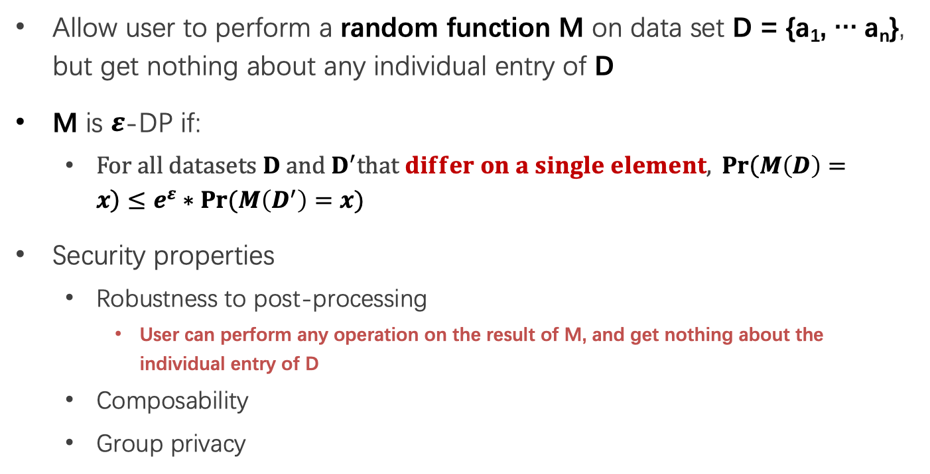
Differential privacy
Allow user to perform a random function M on data set D = {a₁, … a_{n}}, but get nothing about any individual entry of D
M is $ε$-DP if:
  $For all datasets D and D^{′}that differ on a single element,{Pr\left(M\left(D\right)=x\right)}≤e^{ε}∗Pr⁡(M\left(D^{′}\right)=x)$
Security properties
  Robustness to post-processing
    User can perform any operation on the result of M, and get nothing about the individual entry of D
  Composability
  Group privacy

Slide 53
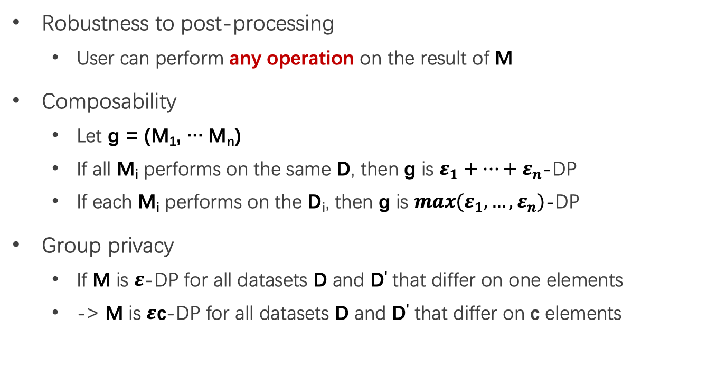
Properties of Differential privacy
Robustness to post-processing
  User can perform any operation on the result of M
Composability
  Let g = (M₁, … M_{n})
  If all M_{i} performs on the same D, then g is $ε_{1}+…+ε_{n}$-DP
  If each M_{i} performs on the D_{i}, then g is ${max(ε}_{1},…,ε_{n})$-DP
Group privacy
  If M is $ε$-DP for all datasets D and D' that differ on one elements
  -> M is $ε$c-DP for all datasets D and D' that differ on c elements

Slide 54
When DP is Enabled
F…
Name | Salary
Alice | 100
Bob | 80
Brown | 200
Tom | 120
SUM(Salary)
~480
SUM(Salary) where Name != "Tom"
~480

Slide 55
How to Implement a DP Algorithm
Adding noisy to the function that we want to compute
  Translate the function f to a random algorithm M
Existing Mechanism
  Laplace mechanism
  Gaussian mechanism
  …

Slide 56
Occlumency
Occlumency: Privacy-preserving Remote Deep-learning Inference Using SGX (MobiCom’2019）

Slide 57
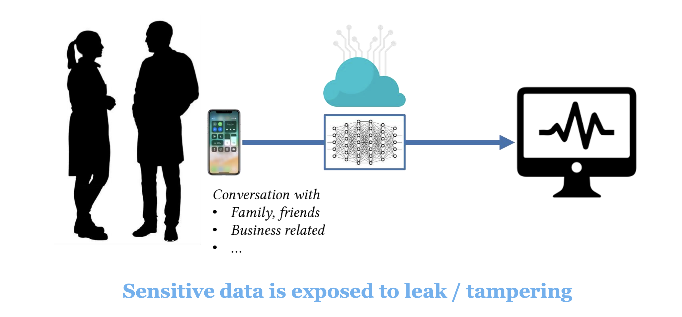
Concerns in Cloud-driven Deep Learning

Slide 58
Cloud Offloading is Inevitable, but Risky
Practical method to support mobile DL
  Easily supports a large model with high accuracy
  Consumes less resources
  Addresses device heterogeneity
Privacy concerns!
  User data can be disclosed
  Image, video, audio, activities, health/medical data
More critical for mobile/IoT services
  Life-immersive: data from users’ daily life

Slide 59
Cloud Offloading is Inevitable, but Risky
Cloud
High computational power
Sacrifices privacy
On-device
High privacy protection
Sacrifices accuracy/speed
This paper aims to build a secure cloud-based solution
to strike the balance between privacy, speed and accuracy

Slide 60
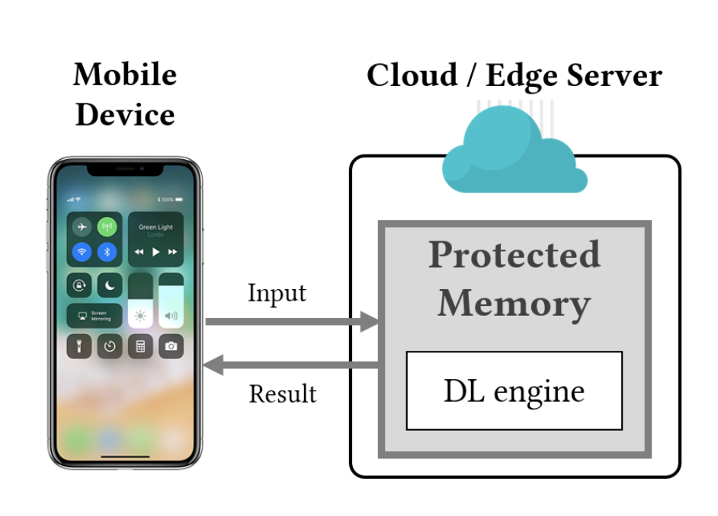
Occlumency
A cloud-driven DL inference system preserving user privacy
Key approach: SGX enclaves
  Commodity TEE with the highest protection level
  Prevent memory access even from OS / hypervisor
Protects:
  User data disclosure
  Inference result manipulation

Slide 61
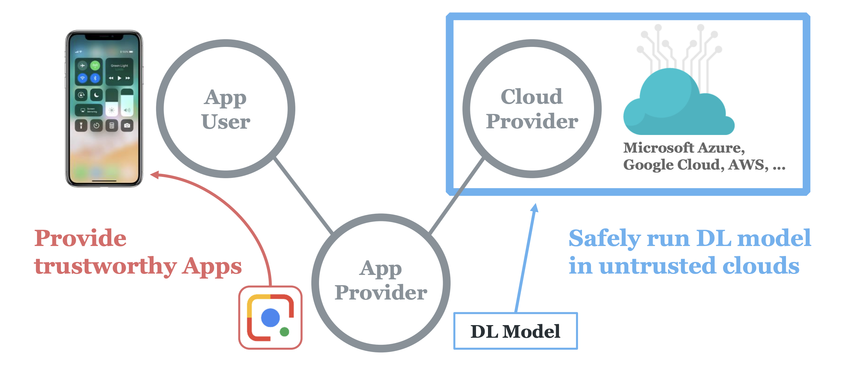
Stakeholders of Occlumency

Slide 62
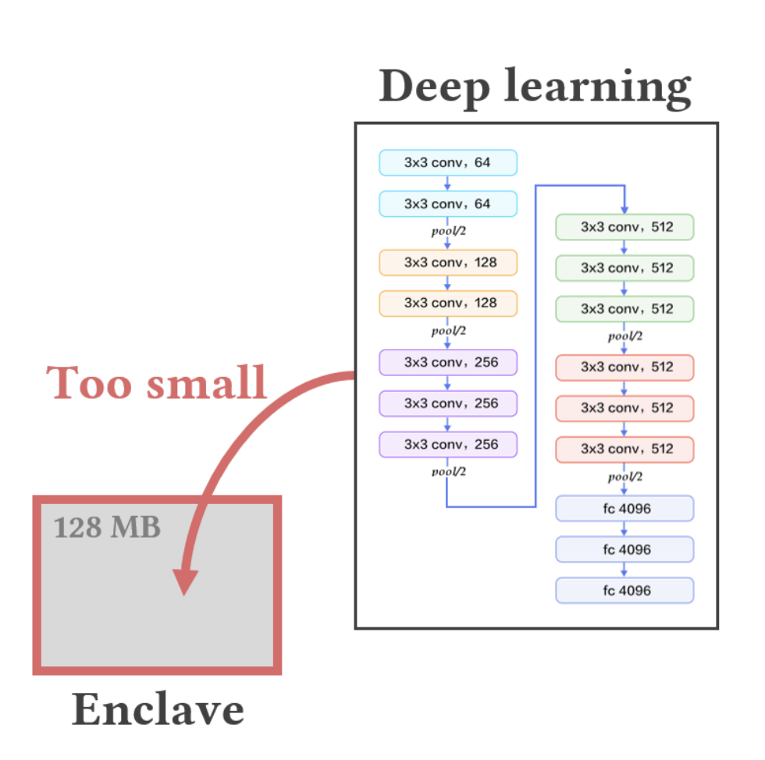
Challenge: Limited Memory Size
SGX’s physical memory is very small (128 MB)
  DNN requires 100MB ~ 1GB of memory
  Windows -- fails
  Linux -- makes frequent page swapping

Slide 63
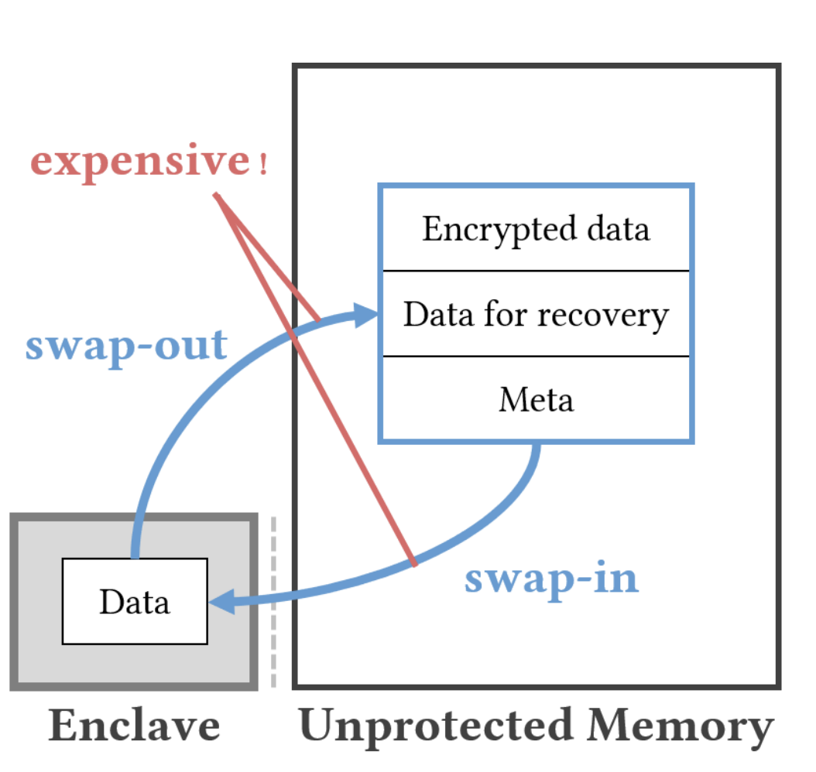
Challenge: Limited Memory Size
SGX’s physical memory is very small (128 MB)
  DNN requires 100MB ~ 1GB of memory DNN
  ⇒ Frequent page swapping
SGX’s paging is expensive
  Swaps-out memory into untrusted memory
  Involves encryption, redundancy checking, ...
SGX slows down the inference speed
  Takes 7x longer latency to infer VGG, YOLO

Slide 64
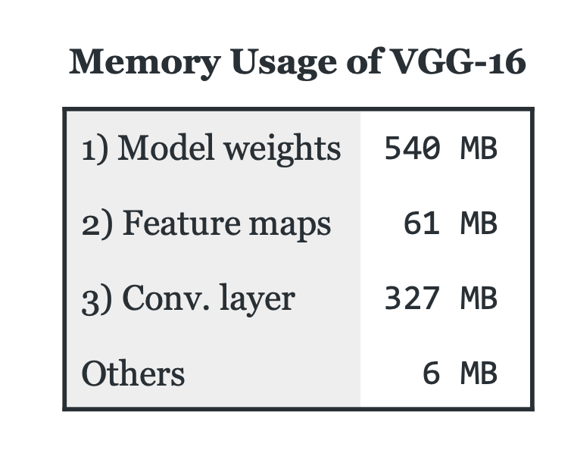
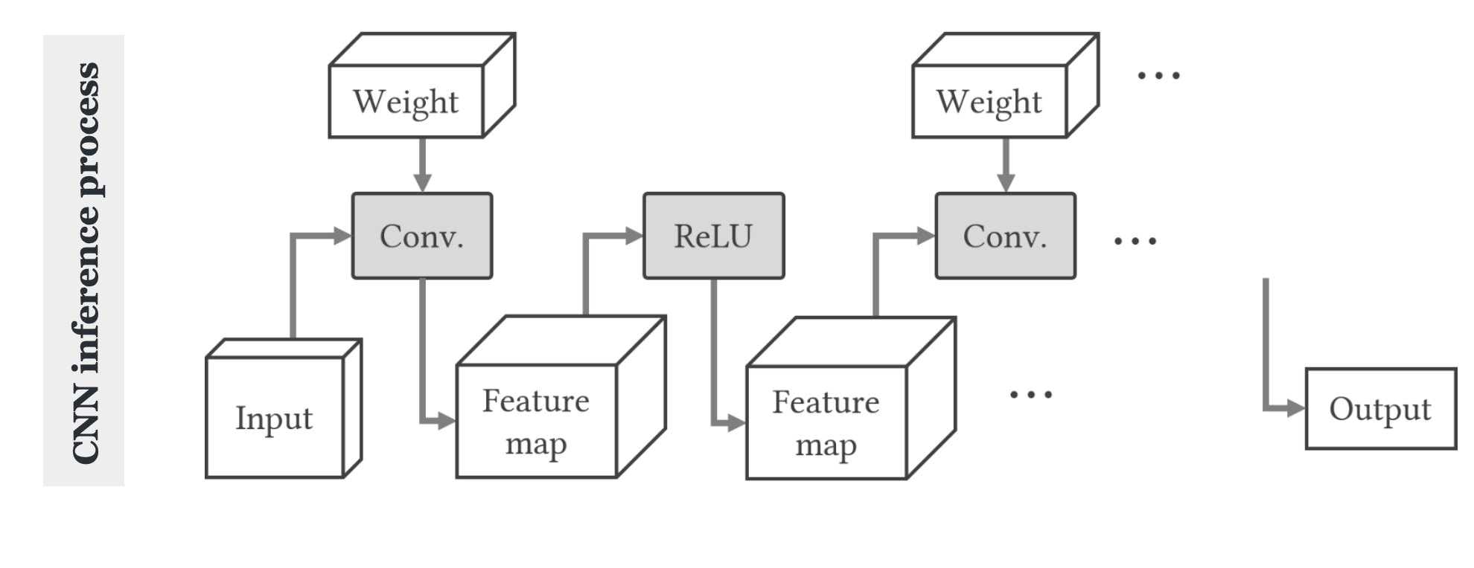
Enabling DL to Run within Small Memory
Observation -- three dominant memory usages of DNN:
1) Model weights (parameters)
2) Intermediate feature maps
3) Conv. layer computation

Slide 65
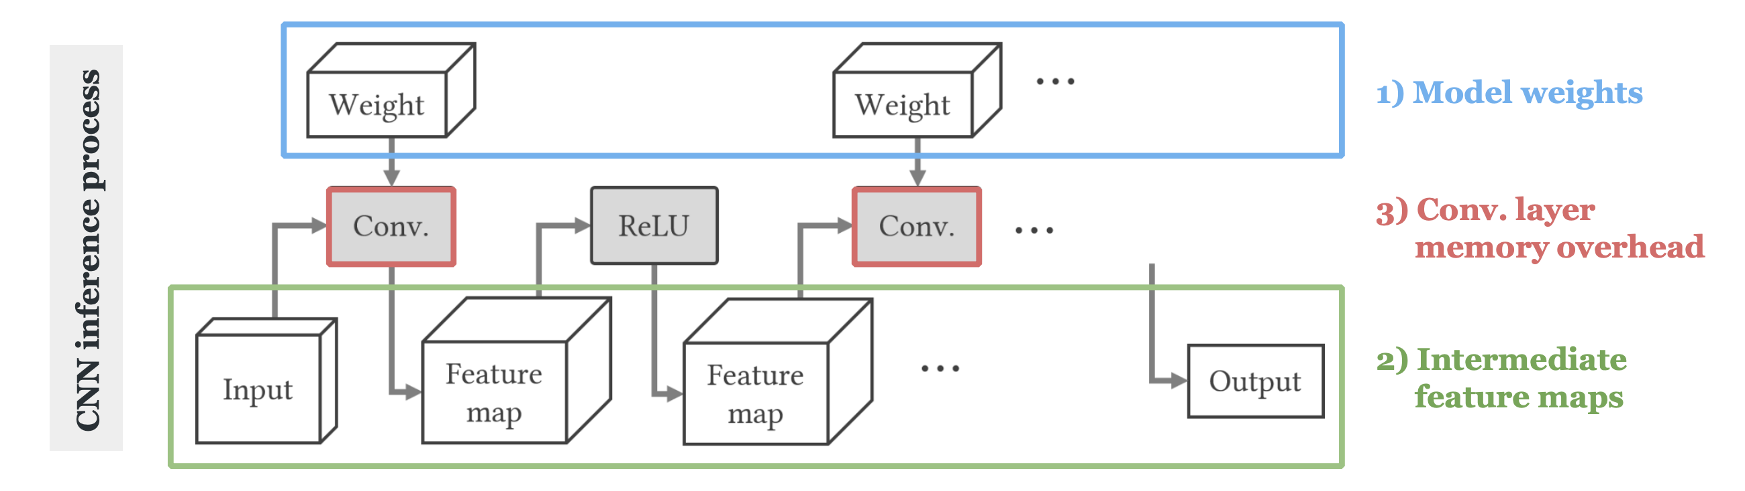
Enabling DL to Run within Small Memory
Observation -- three dominant memory usages of DNN:
1) Model weights (parameters)
2) Intermediate feature maps
3) Conv. layer computation

Slide 66
Approach of Occlumency
1) Model weights (parameters)
2) Intermediate feature maps
3) Conv. layer computation
1) On-demand weight loading
2) Memory-efficient FM allocation
3) Partitioned convolution

Slide 67
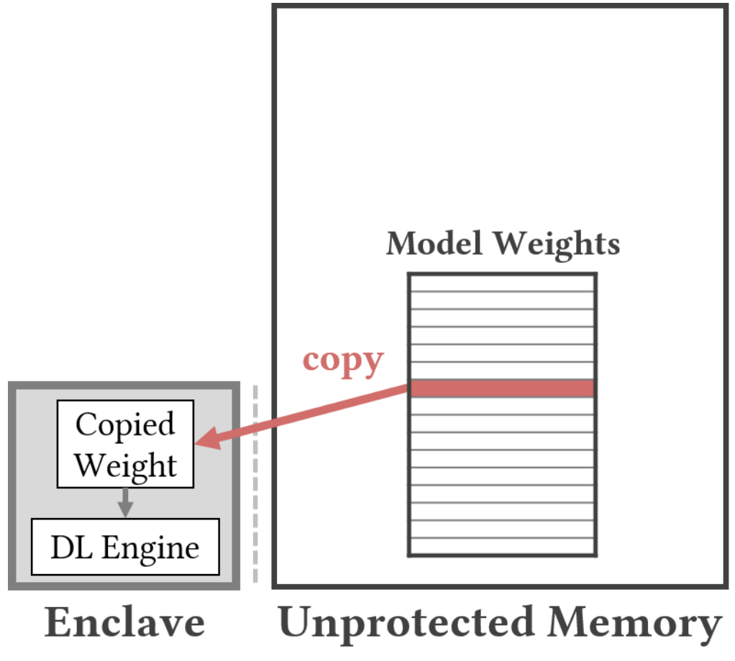
1) On-demand Weights Loading
Saves memory used to load weights (~500MB for VGG-16)
Idea: Not protecting model weights
  Our goal is to protect the user privacy
  Model weights are irrelevant to user data
Keeps weight in unprotected memory & copies into enclaves on demand

Slide 68
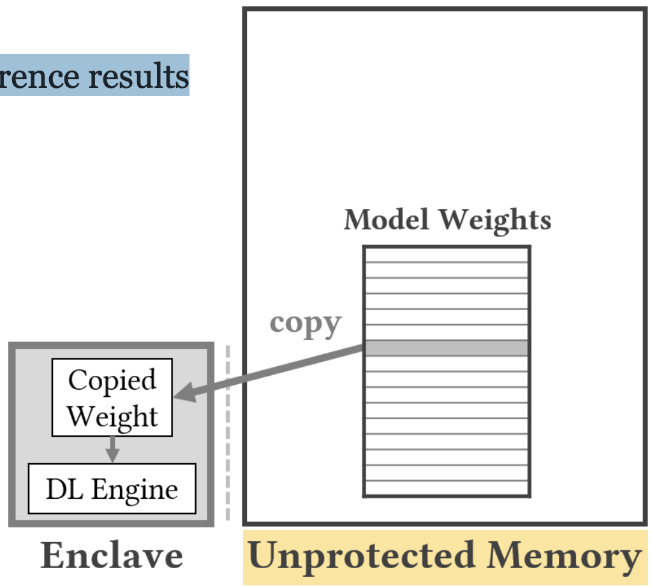
1-1) New Problem 1: Weight Corruption Threat
Weight may be corrupted
  Weights are no longer protected in enclaves
  Weight manipulation attacks will lead to wrong inference results
Solution: Model integrity checking
  Hash checking-based weight modification detection
  Compares hash value of each layer

Slide 69
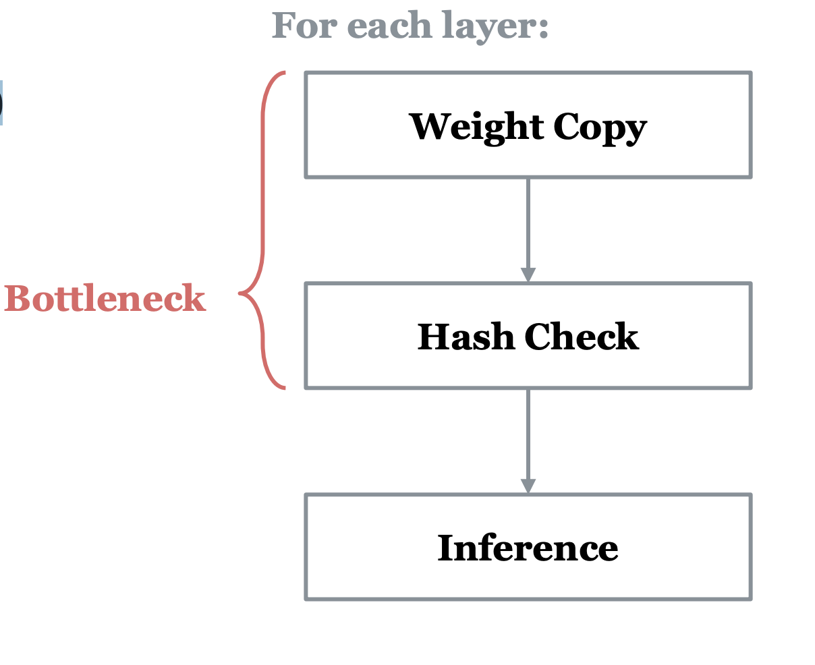
1-2) New Problem 2: Computation Bottleneck
Additional computation bottlenecks:
  Weight copying (on-demand weight loading)
  Hash checking (model integrity checking)
Parallel pipeline
  Weight copy / Hash check / Inference
  Reduces ~17.5% of latency

Slide 70
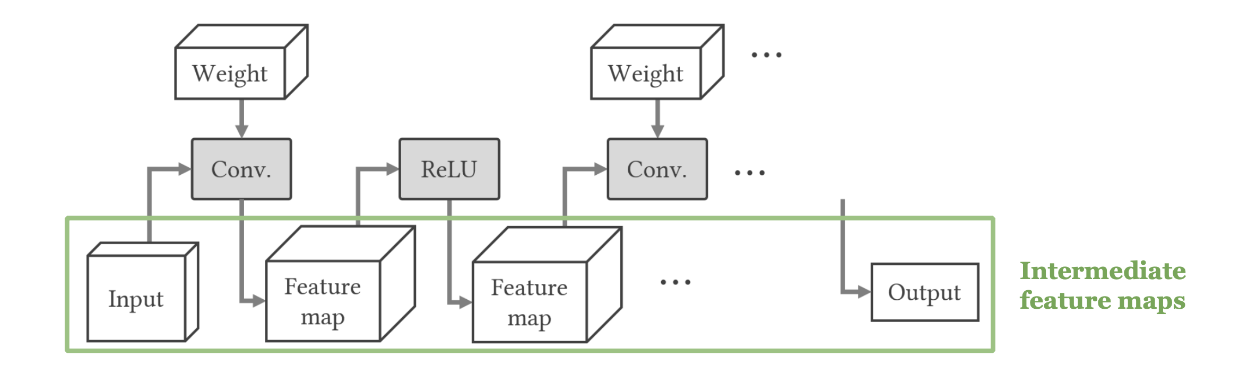
2) Memory-efficient Feature Map Allocation
Reduces the required memory to load intermediate feature-maps (FM)
Idea: Releasing unnecessary FMs
  Profiles when each FM can be released in advance
  Immediately deallocates FMs already used

Slide 71
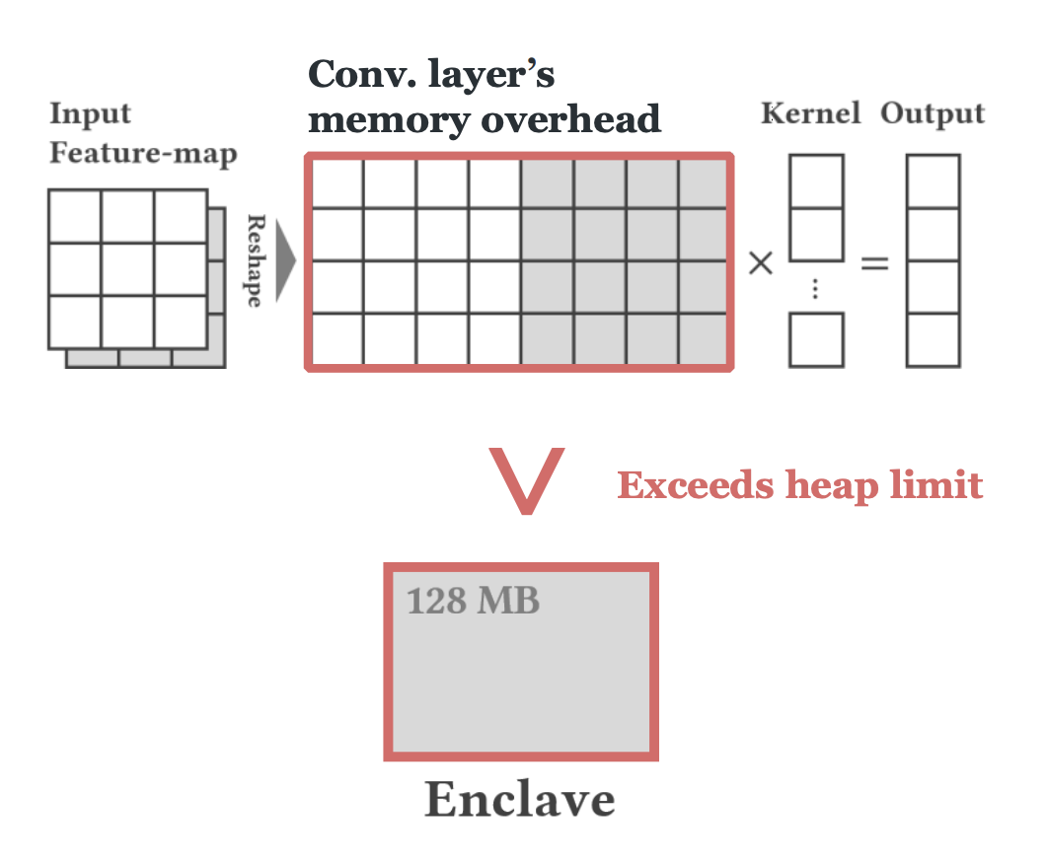
3) Partitioned Convolution
Reduces memory overhead of Conv. that exceeds the SGX heap limit

Slide 72
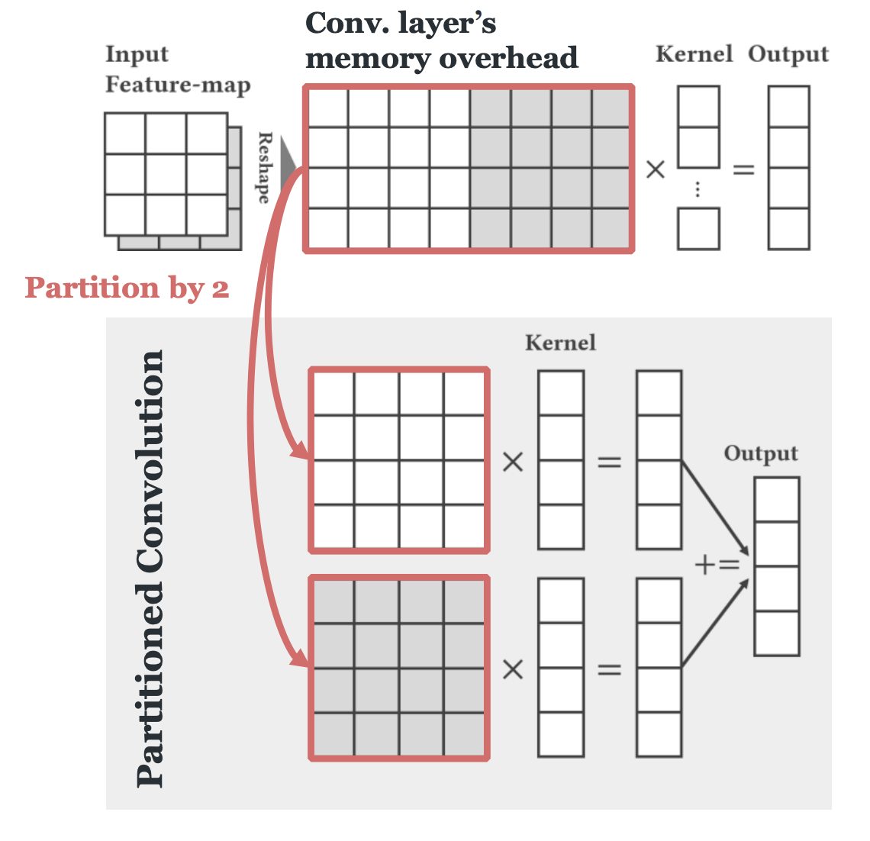
3) Partitioned Convolution
Reduces memory overhead of Conv. that exceeds the SGX heap limit
Idea: Breaking down big operations into smaller jobs
  e.g., Partition by 2 → requires 2x less memory

Slide 73
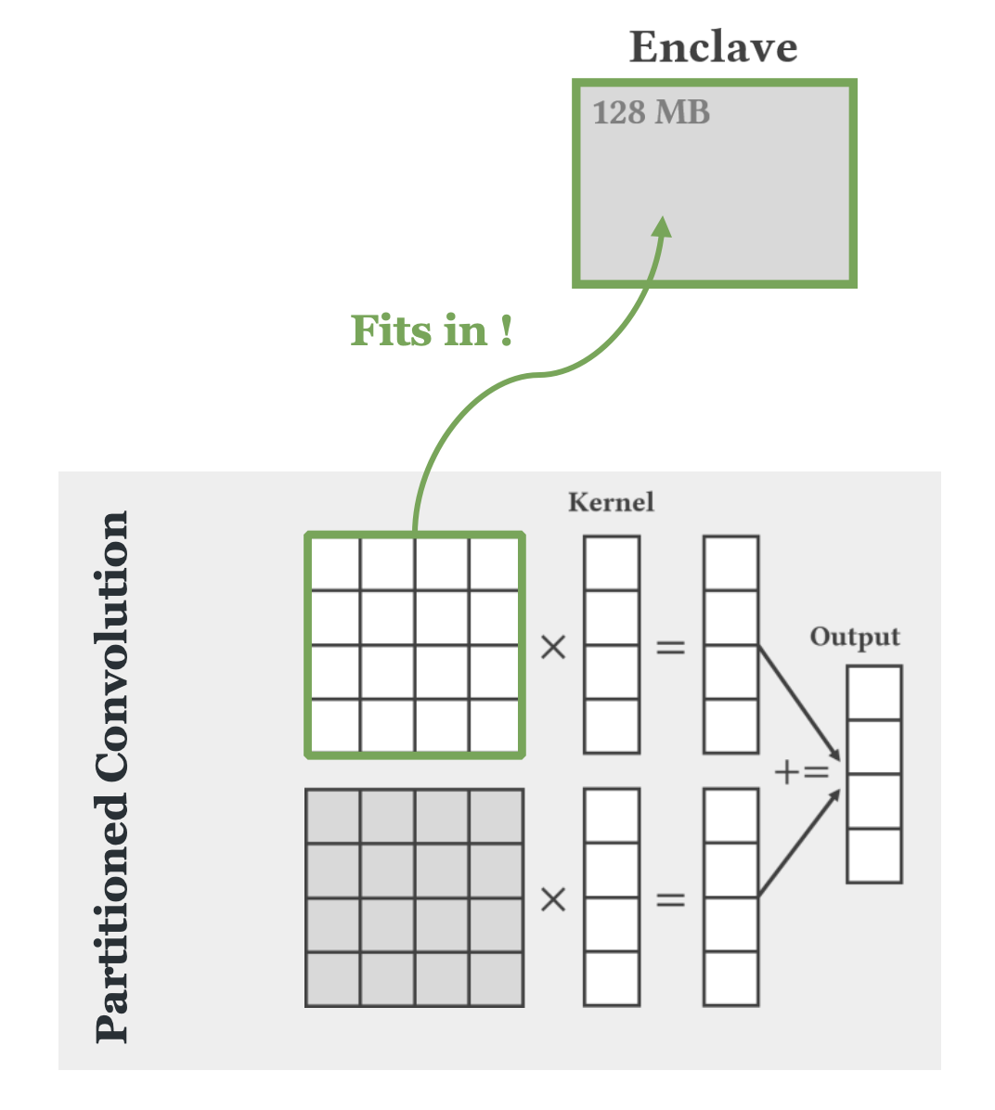
3) Partitioned Convolution
Reduces memory overhead of Conv. that exceeds the SGX heap limit
Idea: Breaking down big operations into smaller jobs
  e.g., Partition by 2 → requires 2x less memory
Adaptively partitions by 2, 4, 8, …
  Runs Conv. layer within limited memory size

Slide 74
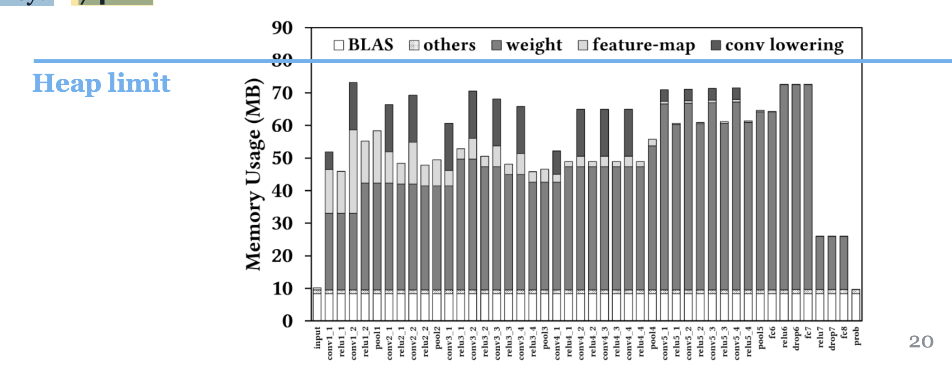
Memory Usage Evaluation
1) Can Occlumency run DNN within SGX's memory limit?
  Occlumency successfully runs DNN models within SGX's heap limit
  Ex) Reduced memory for VGG-19:
    Original: 980MB
    Occlumency: 74MB

Slide 75
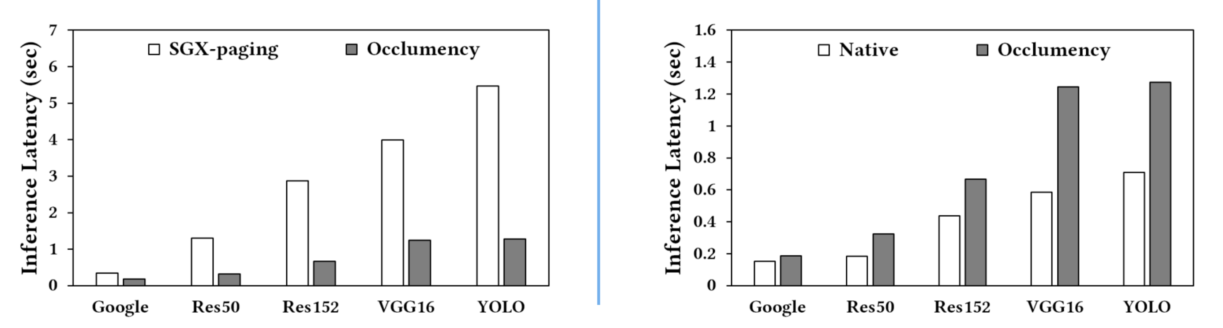
Inference Latency Evaluation
2) How much the Occlumency can enhance the inference speed?
  3.0 ~ 4.3x faster than SGX-paging
3) How much is the overhead of Occlumency?
  72% overhead compared to Native

Slide 76
Oblivious Multi-Party Machine
Oblivious Multi-Party Machine Learning on Trusted Processors (USENIX Security'2016)

Slide 77
Machine Learning on Cloud
Cloud

Slide 78
Machine Learning on Cloud
ML Code
APP
OS
Large Attack Surface!
Sensitive Data Could be Stolen!
Hypervisor
Hardware
Cloud

Slide 79
Machine Learning on Cloud with TEE
ML Code
APP
OS
Hypervisor
Hardware
Cloud

Slide 80
Threat Model
Any party may be malicious
The cloud can be malicious
  Memory & Network observer
  Hardware attackers (on mem bus)
  Perform side-channel attacks
Assumptions:
  Code does not leak secrets
  Do not consider leakage through time or power channels

Slide 81
System Design
Data: encryption
  Input and output are encrypted
  Data outside of enclave is encrypted
Code: secure enclave
  Trusted processors (SGX)
Data accesses:
  Side channel protection
  Memory, disk, and network are accessed obliviously
Output
Secure Enclave
ML Code
oblivious
access

Slide 82
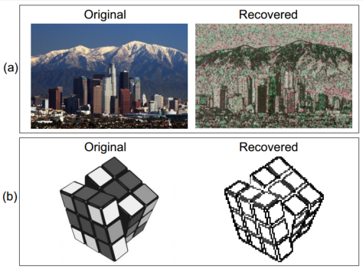
SGX's Vulnerabilities
Side channel attack
  Malicious OS still controls page fault handler
  If know the photo processing algorithm, can get the image by monitoring page fault
  Not 100% accurate, but still good enough

Slide 83
Side-channel Protection
Memory side-channel
Security guarantee:
  Data oblivious
  Given two inputs and a memory trace, one cannot distinguish which one was executed
Memory accesses only depends on public information
  E.g., number of instances, number of labels
Assumption: register-to-register manipulation is data oblivious

Slide 84
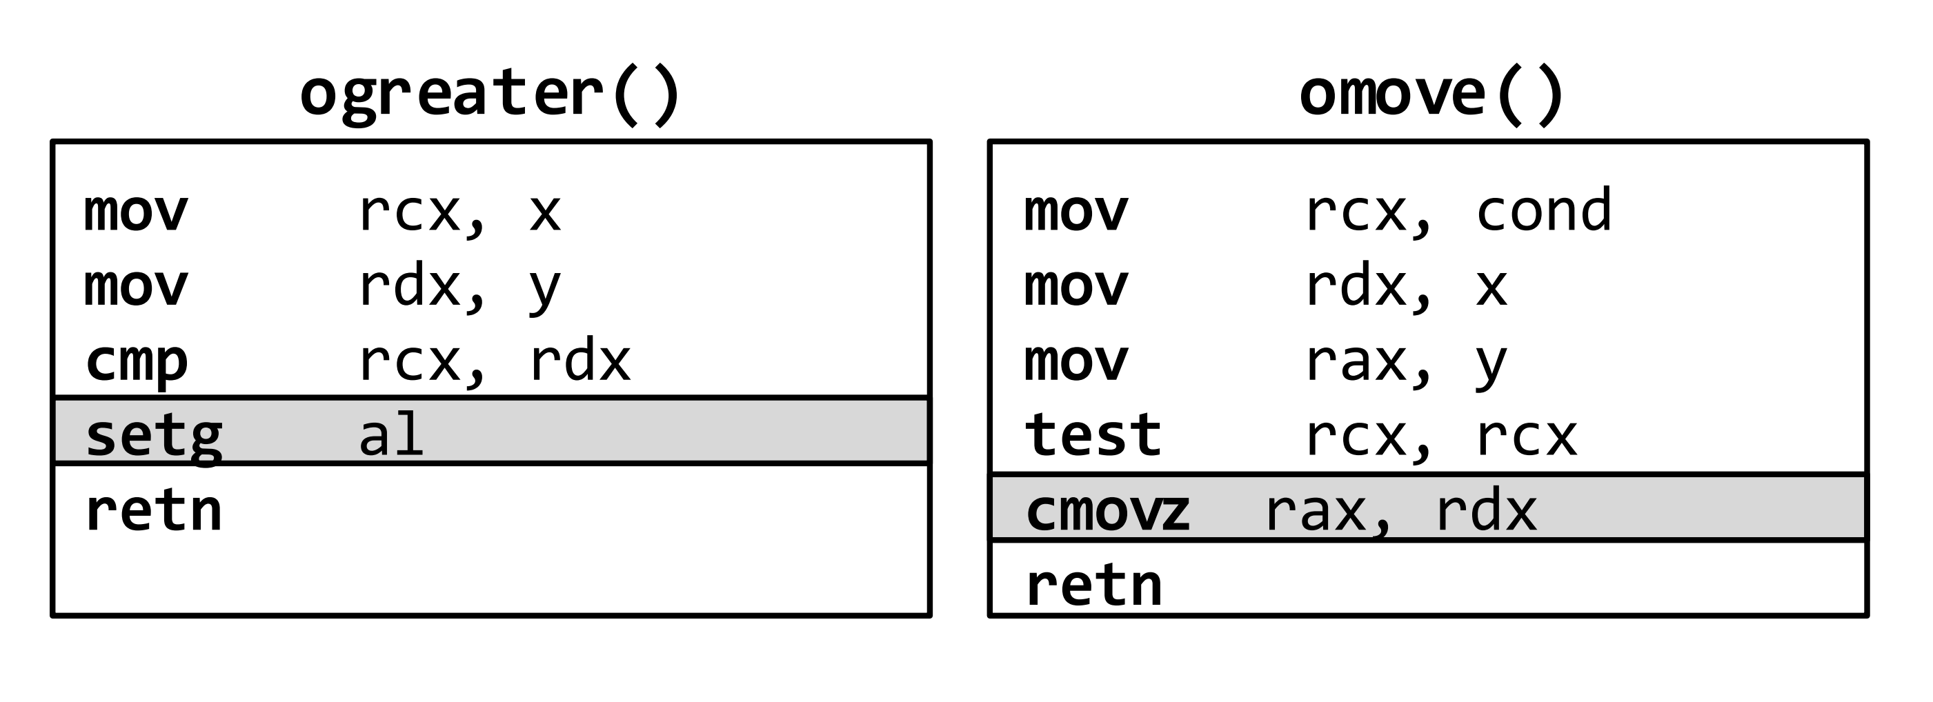
Library of Oblivious Primitives LibO
In assembly:
  ogreater, omove, oless, oequal
  oget
    get the ith array element (hide i)

Slide 85
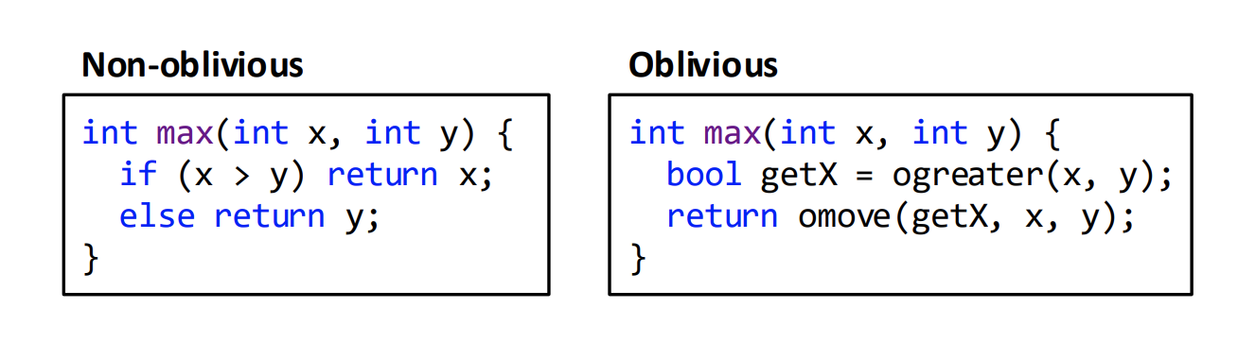
Oblivious Operation

Slide 86
Optimized Oblivious Array Access
Naïve method
  Scan the array
  Just actually load/store a single element
Observation
  Attacker can only trace memory access at cache line granularity
Optimization
  Scan arrays at cache line granularity
  Leveraging AVX2 vector instructions

Slide 87
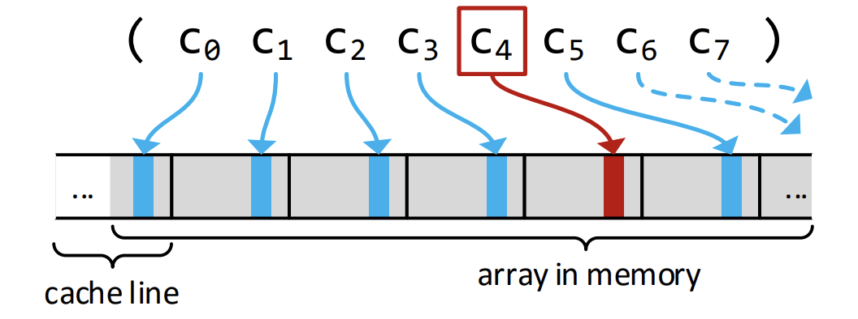
Optimized Oblivious Array Access

Slide 88
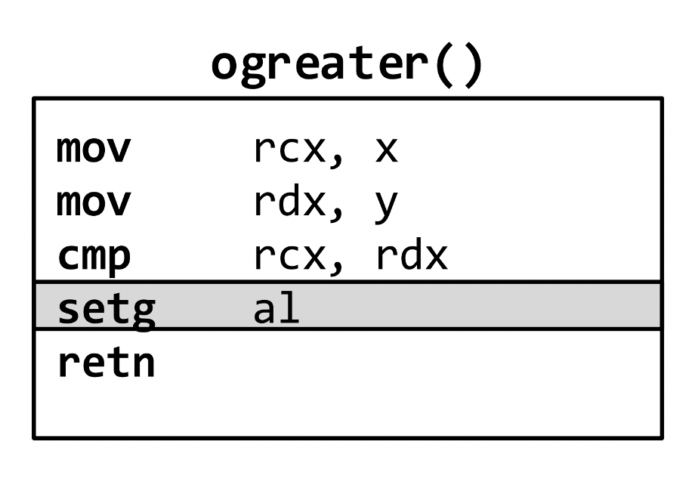
Oblivious Decision Trees
Decision tree often stored as array
Things we want to hide:
How we evaluate the comparison at each node
  Using ogreater
Which node we actually traverse (not the level)

Slide 89
Oblivious Decision Trees
Decision tree often stored as array
Things we want to hide:
How we evaluate the comparison at each node
  Using ogreater
Which node we actually traverse (not the level)
  Oblivious array access

Slide 90
Other Oblivious ML Algorithms
Decision trees
Support Vector Machines
Neural Network
Matrix Factorization
K-Means clustering

Slide 91
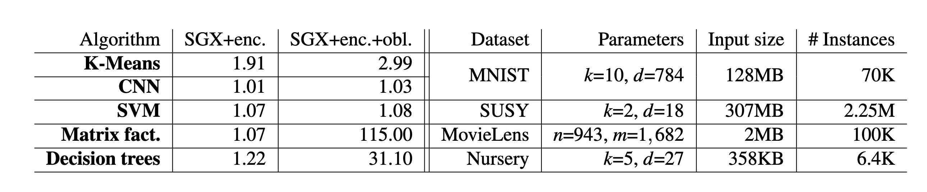
Evaluation
Baseline is processing the data in plaintext without SGX protection.

Slide 92
Different Data Privacy Systems
Data privacy + ML
  Sage (SOSP'19)
  Oblivious multi-party ML (USENIX Security'16)
  Chiron, …
Data privacy + Database
  CryptDB (SOSP'11)
  EnclaveDB (S&P'18), …
Data privacy + Data analysis
  Opaque (NDSI'17)
More …

